Slide 1
Como programar como o coelho assassino de Caerbannog
Ikke

Slide 2
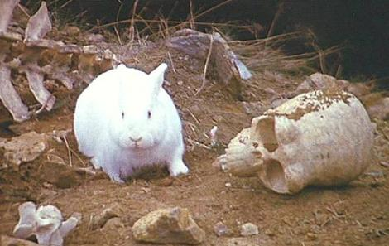
Beautiful is better than ugly.

Slide 3
Java Code
Sample

Slide 4
Python Code
Sample

Slide 5

Explicit is better than implicit.

Slide 6
Python Code
From foo import *
Algo()
Import foo
foo.algo()

Slide 7

Simple is better than complex.

Slide 8
Python Code
def mdc(x, y):
while y:
x, y = y, x % y
return x

Slide 9

Complex is better than complicated.

Slide 10
Python Code
x = [a+b, a-b, a*b][(a>4)+(b>6)
If a>4 and b>6:
x = a*b
Elif a > 4 or b > 6:
x = a – b
Else:
x = a + b

Slide 11

Flat is better than nested.

Slide 12
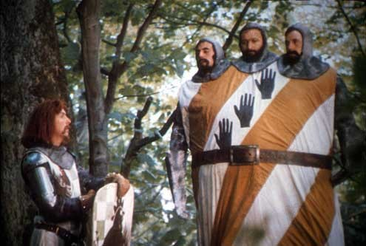
Sparse is better than dense.

Slide 13
Python Code
if i>0: return sqrt(i)
elif i==0: return 0
else: return 1j * sqrt(-i)
if i > 0:
return sqrt(i)
elif i == 0:
return 0
else:
return 1j * sqrt(-i)

Slide 14
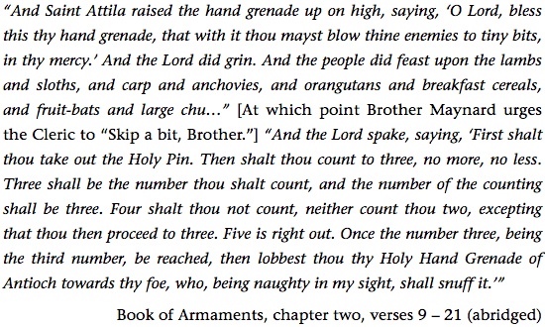
Readability counts.

Slide 17
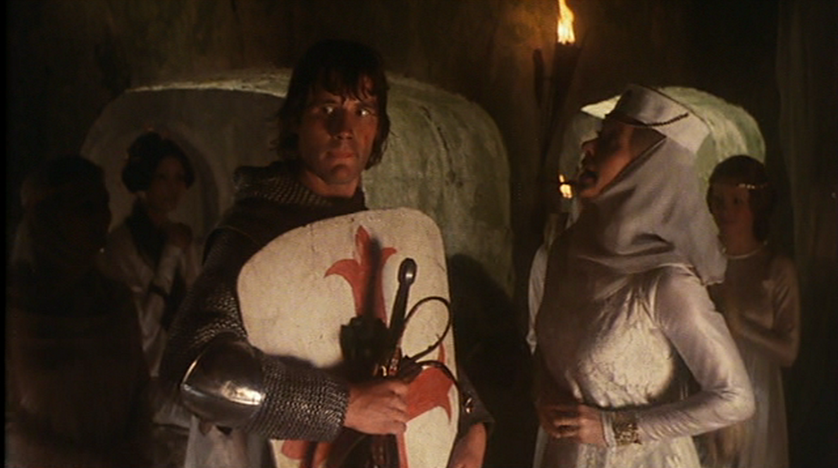
Special cases aren't special enough to break the rules.

Slide 18
>>> type("ninjas")
<type 'str'>
>>> type("n")
<type 'str'>

Slide 19

Although practicality beats purity.

Slide 20
Chr() e ord()

Slide 21

Errors should never pass silently.

Slide 22
try:
v = d[k]
except KeyError:
print “Chave não cadastrada”

Slide 23

Unless explicitly silenced.

Slide 24
try:
v = d[k]
except KeyError:
v = d[k] = None

Slide 25
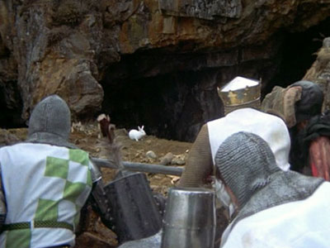
In the face of ambiguity, refuse the temptation to guess.

Slide 26
>>> True, False = b = False, True = (c,d) = (100,200)
>>> print True
200
>>> print False
100
>>> print a
100
>>> print b
200

Slide 27
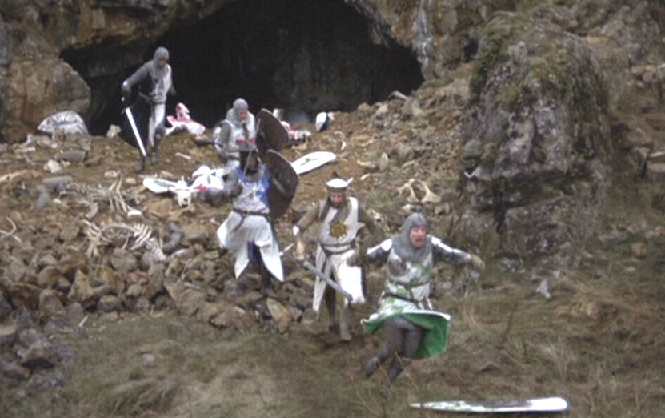
There should be one-- and preferably only one --obvious way to do it.

Slide 28
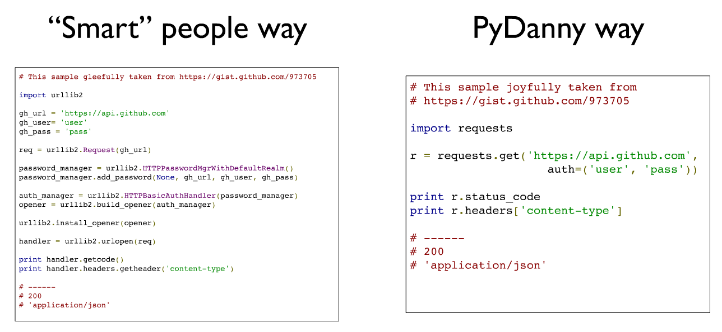

Slide 29
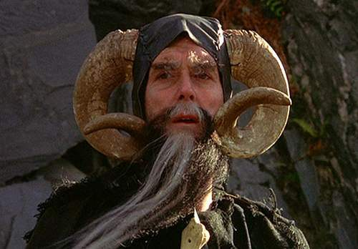
Although that way may not be obvious at first unless you're Dutch.

Slide 30

Now is better than never.

Slide 31

Although never is often better than *right* now.

Slide 32

If the implementation is hard to explain, it's a bad idea.

Slide 33

If the implementation is easy to explain, it may be a good idea.

Slide 34
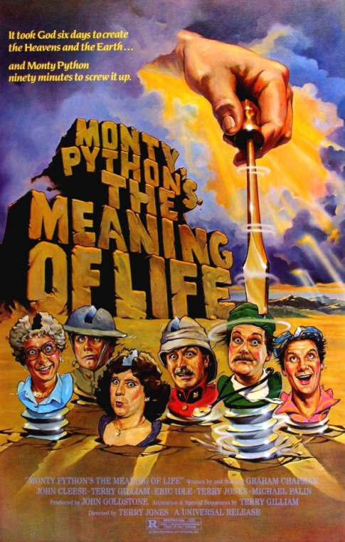
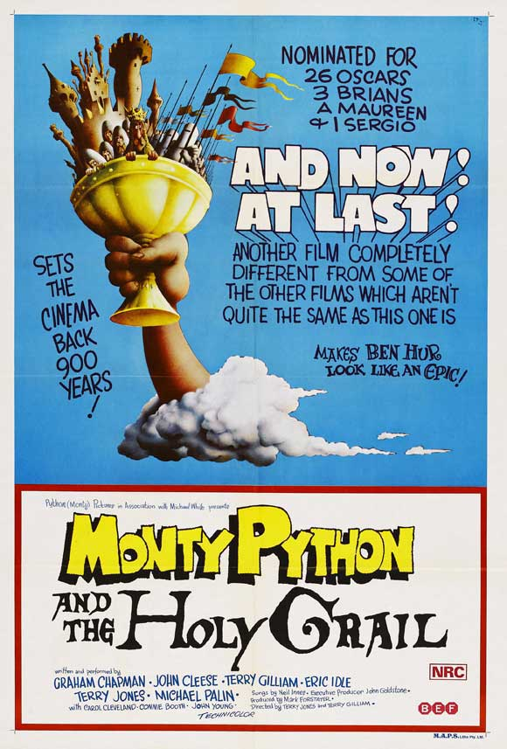
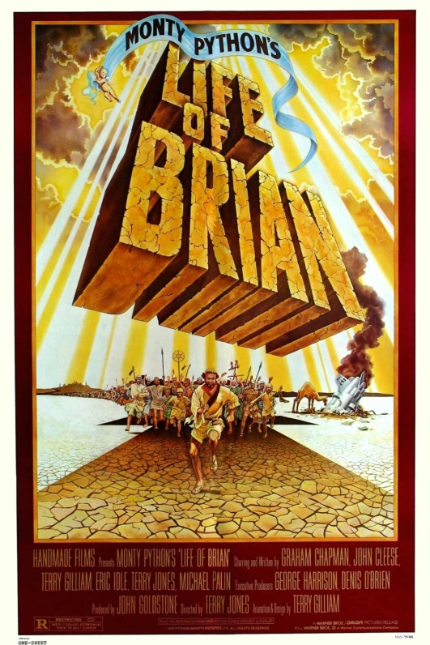
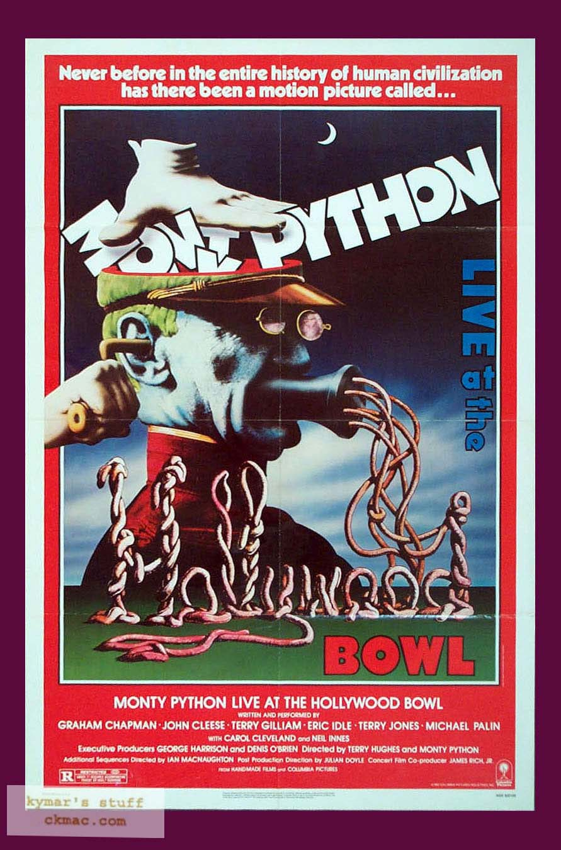
Namespaces are one honking great idea -- let's do more of those!

